Slide 1
How to use: The Cover Crop Competitive Quiz Game
Designate someone the score keeper.
Open the Grid Table.
Have participant select a category and point value.
Click on the point value, which will open the clue.
To reveal the answer, click on the ANSWER hyperlink at the bottom right-hand corner of the screen.
The answer slide will appear.
To return to the main grid table, click the answer you are viewing. It’s hyperlinked back to the grid table.
Select another category and point value and continue
Side note: all clues are hyperlinked back to the main grid board as well; incase you need to return from some reason.
Developed by Marlon Winger and Keela Deaton: NRCS

Slide 2
Cover Crop Jeopardy

Slide 3
Cool Season Grasses | Warm Season Grasses | Cool Season Broadleaves | Warm Season Broadleaves | Soil Health | Fun Cover Crop Facts
200 | 200 | 200 | 200 | 200 | 200
400 | 400 | 400 | 400 | 400 | 400
600 | 600 | 600 | 600 | 600 | 600
800 | 800 | 800 | 800 | 800 | 800
1000 | 1000 | 1000 | 1000 | 1000 | 1000

Slide 4
This is how you make the game, just type the question.
ANSWER

Slide 5
This plant looks like a wild oat
ANSWER

Slide 6
If grazing mature wheat/barley/triticale, you would prefer this seed head trait
ANSWER

Slide 7
This cool season grass will not over winter in northern latitudes
ANSWER

Slide 8
What cover crop functional group has more pronounced rhizosheaths than any other cover crop functional group
ANSWER

Slide 9
Which warm season grass has the most seeds per pound?
ANSWER

Slide 10
Which warm season grass specie has the highest level of prussic acid potential
ANSWER

Slide 11
This family of cover crops makes better hay than sudangrass types
ANSWER

Slide 12
Egyptian Wheat is a member of this family
ANSWER

Slide 13
The main purpose for adding BMR corn in cover crop mixes
ANSWER

Slide 14
What cover crop specie in the brassica family has the deepest tap root?
ANSWER

Slide 15
This cover crop specie gets part of its name from its colorful root
ANSWER

Slide 16
This vetch will generally not survive the winter in northern latitudes
ANSWER

Slide 17
Which family of cover crops form low or no mycorrhizal association?
ANSWER

Slide 18
This cool season broadleaf has anthelmintic properties
ANSWER

Slide 19
What type of bacteria is needed to form a symbiotic relationship that produces a root nodule?
ANSWER

Slide 20
This cover crop will not get you stoned on the weekend
ANSWER

Slide 21
This plant naturally breaks the phosphorous to calcium bond
ANSWER

Slide 22
If you get hungry you could harvest this cover crop for a fried delicacy.
ANSWER

Slide 23
While in the field and a bathroom emergency arises, you would not want to pick this specie for therapeutic papers.
ANSWER

Slide 24
These are the 5 principles of soil health
ANSWER

Slide 25
There are more of these in a handful of soil then there are humans on the earth
ANSWER

Slide 26
This organism feeds on organic material in the soil and converts it into nutrients for the plant and are also handy to have on a fishing trip
ANSWER

Slide 27
This specific area between two fields generally has the best soil health of the farm/ranch
ANSWER

Slide 28
8.726 tons of soil is the same thickness as this monetary unit
ANSWER

Slide 29
Who is my favorite soil health division specialist?
ANSWER

Slide 30
These two conservation practices work better when implemented together.
ANSWER

Slide 31
If you don’t cover the soil with a live plant this will
ANSWER

Slide 32
Don’t plant your first cover crop plot next to the (BLANK)_as this will be a learning process and you will make some mistakes.
ANSWER

Slide 33
In your sudangrass you notice a brown stripe in the middle of the leaf. This trait is called?
ANSWER

Slide 34
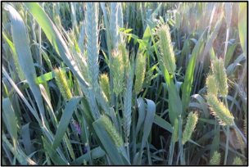
When making the game this is where you write the answer

Slide 35
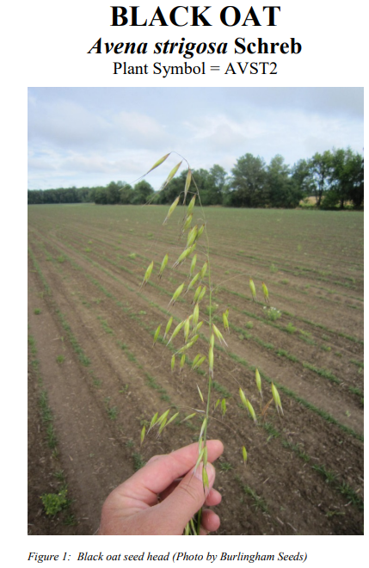
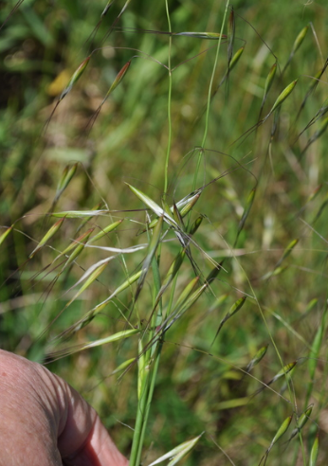
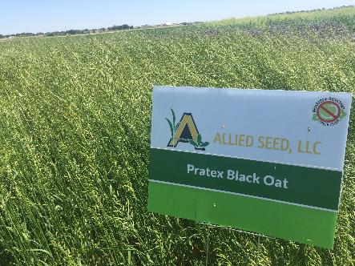
BLACK OAT

Slide 36
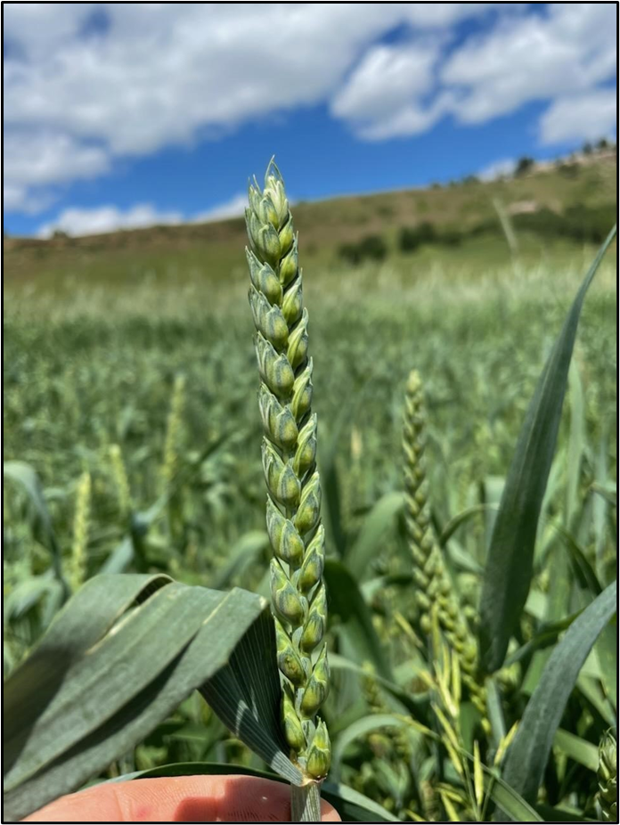
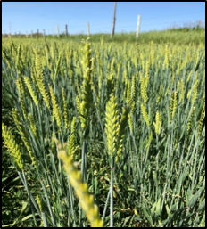
BEARDLESS/AWNLESS VARITIES

Slide 37
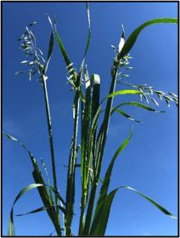
OATS

Slide 38
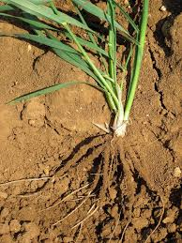
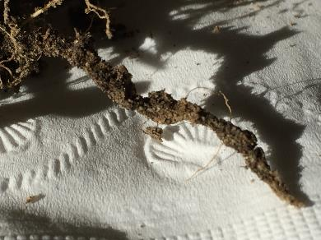
COOL SEASON GRASSES

Slide 39
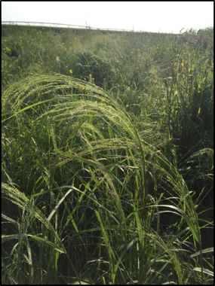
TEFF GRASS
(1.3 Million per pound)

Slide 40
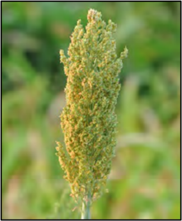
SORGHUM TYPES

Slide 41
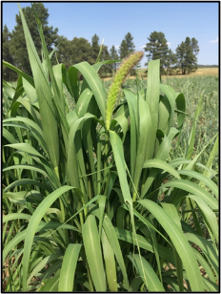
MILLETS

Slide 42
SORGHUM FAMILY

Slide 43
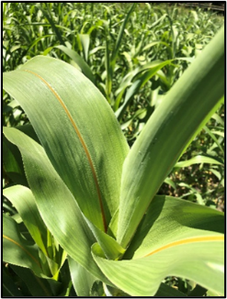
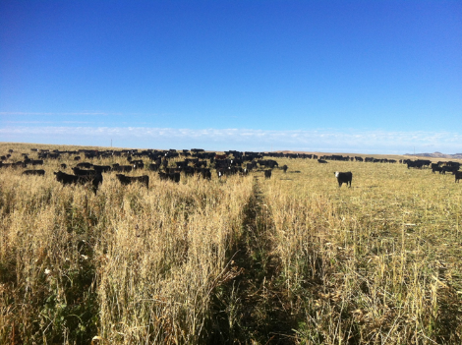
FORAGE/GRAZING

Slide 44
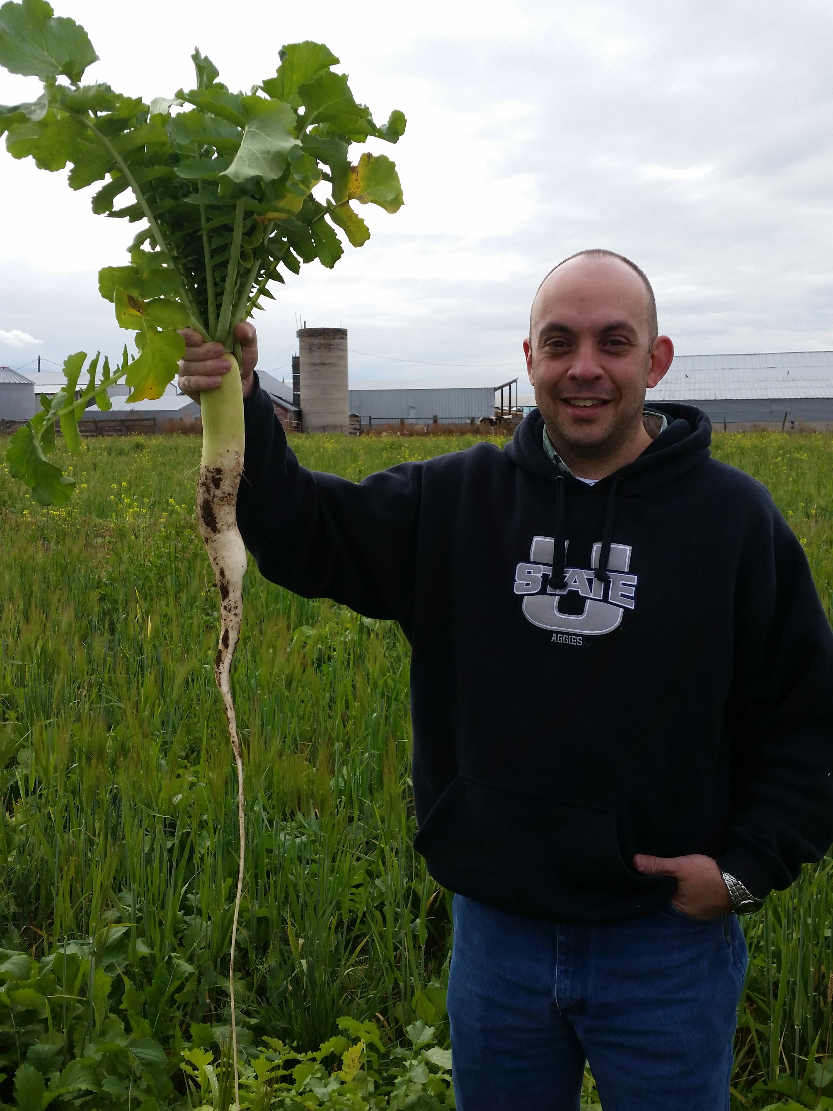
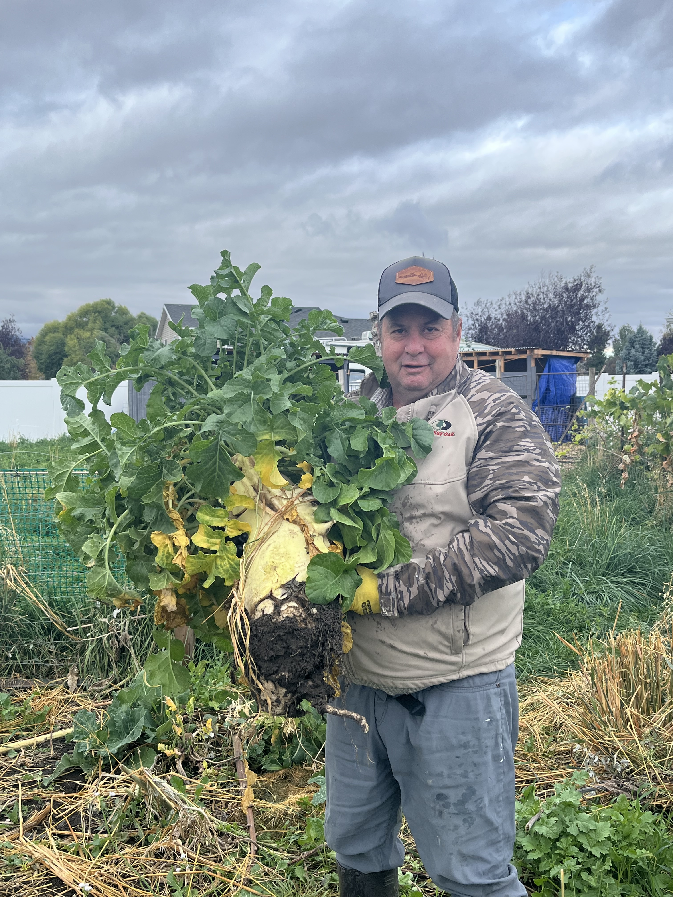
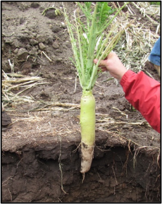
RADISH

Slide 45
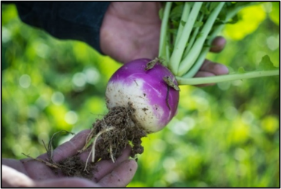
PURPLE TOP TURNIP

Slide 46
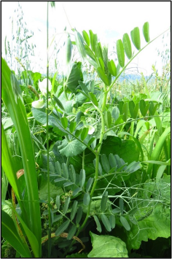
COMMON VETCH

Slide 47
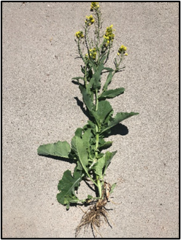
BRASSICAS/MUSTARDS

Slide 48
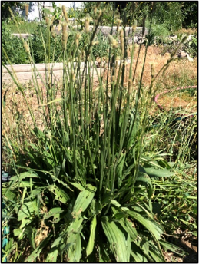
PLANTAIN

Slide 49
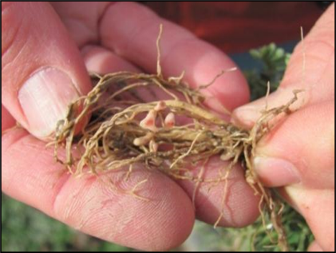
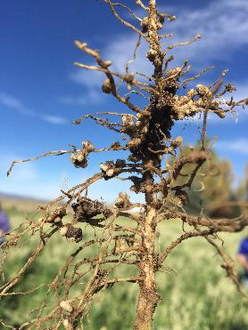
RHIZOBIUM SPECIES

Slide 50
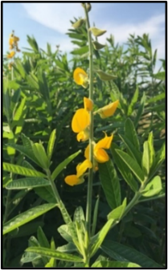
SUNN HEMP

Slide 51
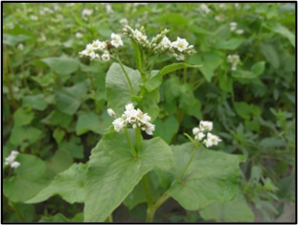
BUCKWHEAT

Slide 52
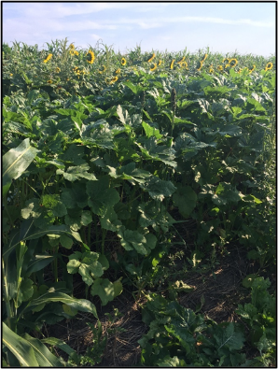
OKRA

Slide 53
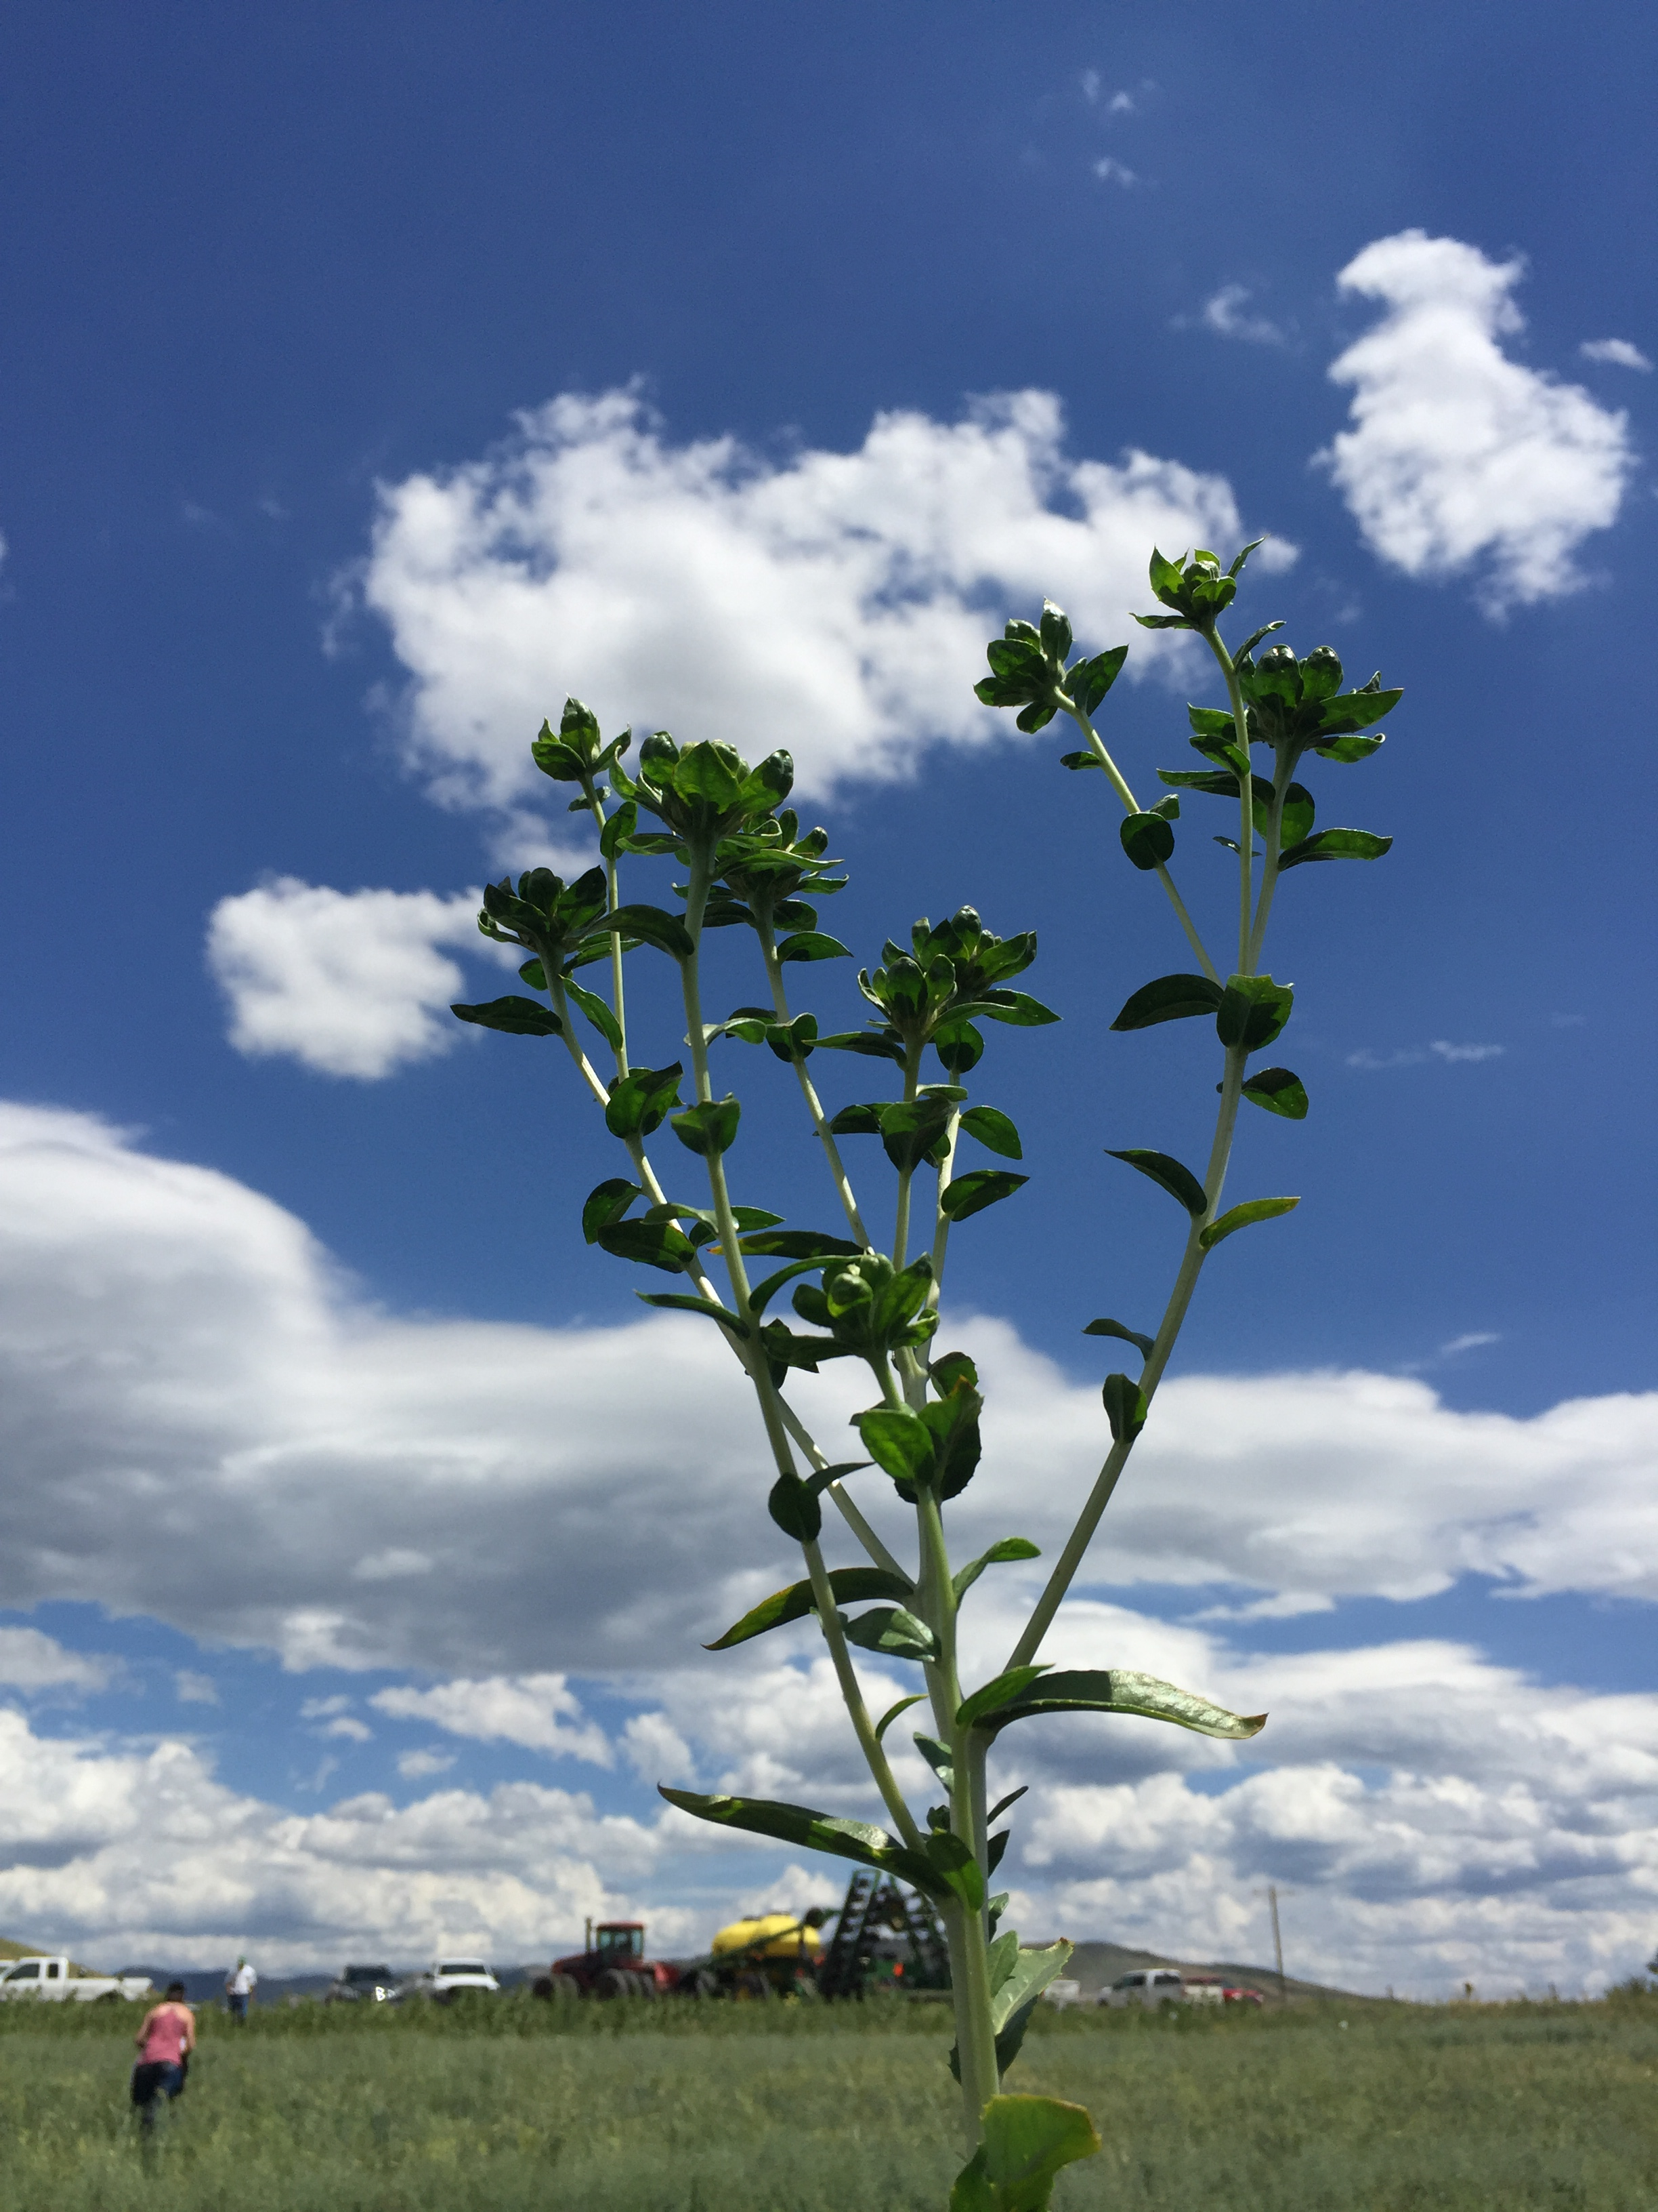
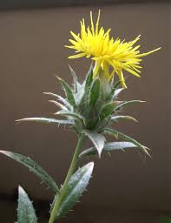
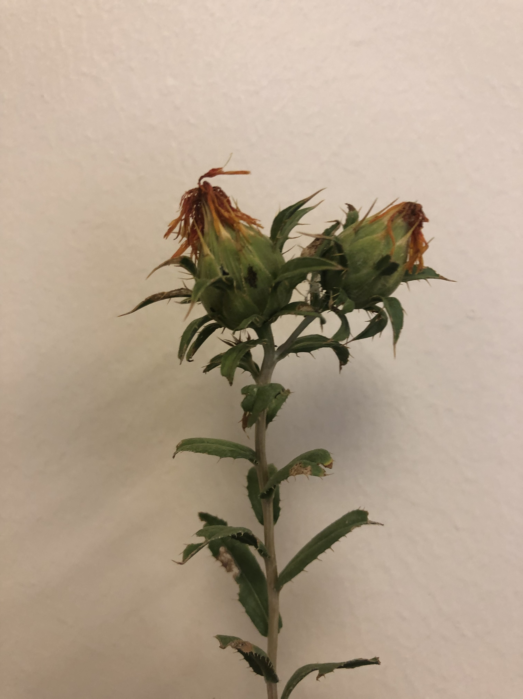
SAFFLOWER
Baldy – no spines

Slide 54
ARMOR THE SOIL
MINIMIZE SOIL DISTURBANCE
PLANT DIVERSITY
CONTINUAL LIVE PLANT/ROOT
INTEGRATE LIVESTOCK

Slide 55
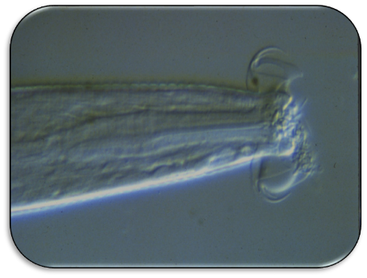
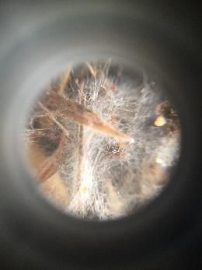
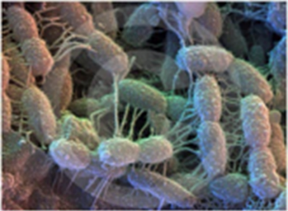
MICROORGANISMS

Slide 56
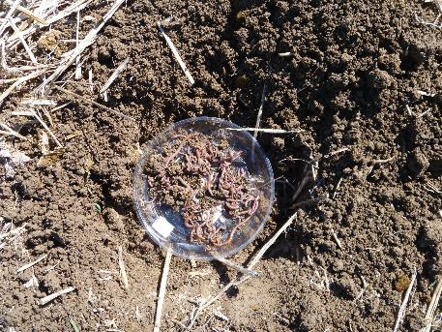
EARTHWORMS

Slide 57
FENCE ROWS

Slide 58
DIME

Slide 59
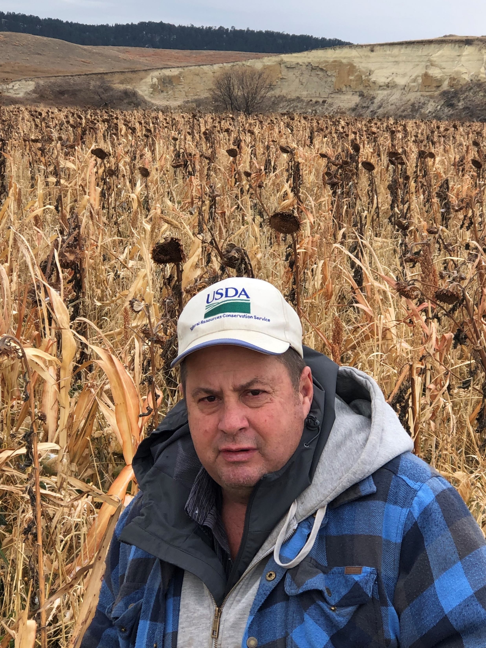
MARLON WINGER

Slide 60
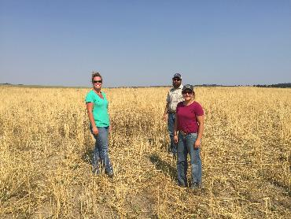
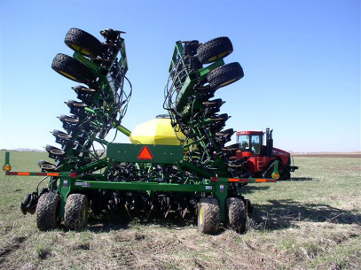
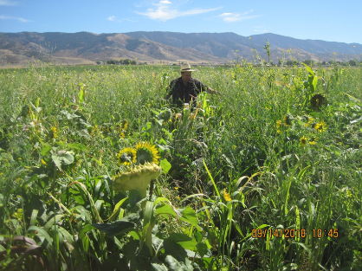
NO-TILL &
COVER CROPS

Slide 61
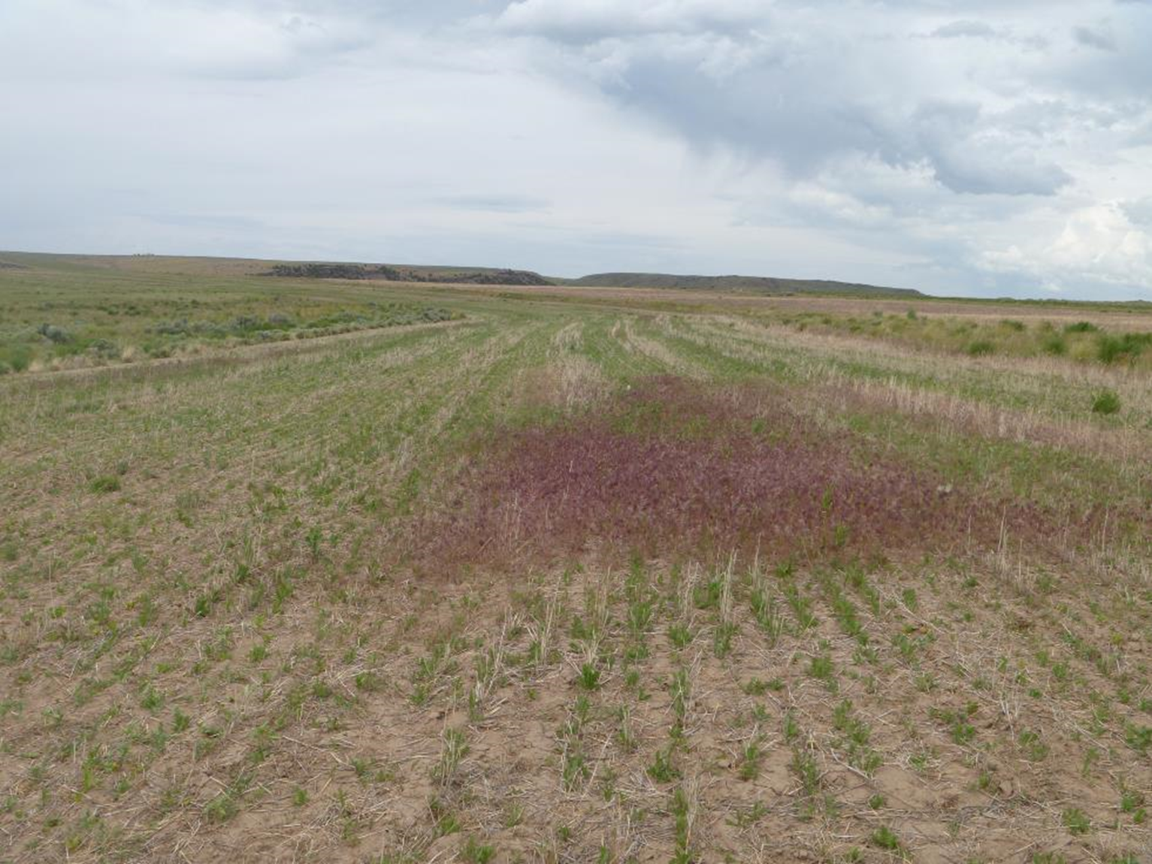
MOTHER NATURE (weeds)

Slide 62
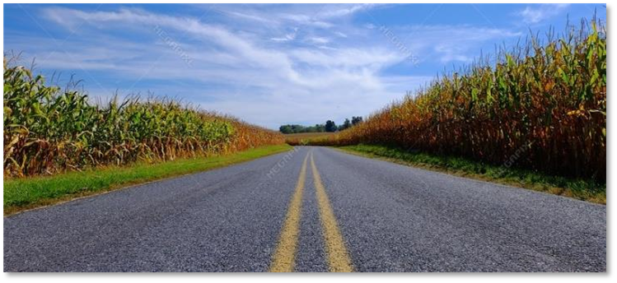
HIGHWAY

Slide 63

BROWN MID-RIB

